Slide 1
Module - 4
Decision Tree
Regression
ANN
Cluster Analysis
Association Rule Mining
Dr. S. NANDAGOPALAN

Slide 2
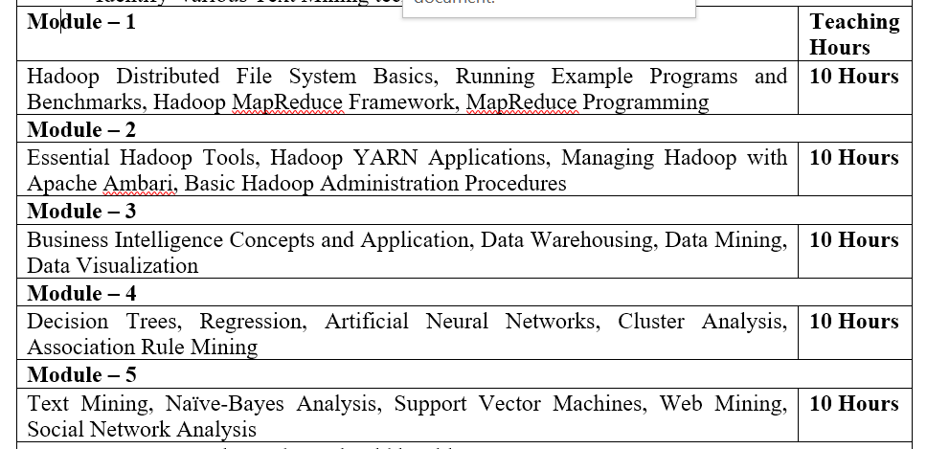
Syllabus

Slide 3
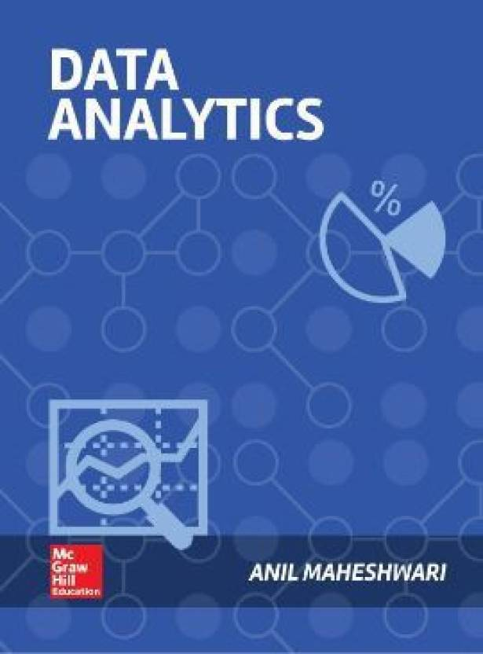
Text Book

Slide 4
Agenda
Decision Tree
Regression
ANN
Cluster Analysis
Association Rule Mining
Summary

Slide 5
Decision Tree

Slide 6
Introduction
Decision trees are a simple way to guide one’s path to a decision.
Decision trees are hierarchically branched structures that help one come to a decision based on asking certain questions in a particular sequence.
The decision may be a simple binary one, whether to approve a loan or not.
Or it may be a complex multivalued decision, as to what may be the diagnosis for a particular sickness.

Slide 7
Case Study
Predicting Heart Attacks Using Decision Trees
A study was done at UC San Diego concerning heart disease patient data.
The patients were diagnosed with a heart attack from chest pain, diagnosed by EKG, high enzyme levels in their heart muscles, and so on.
Predict which of these patients was at risk of dying from a second heart attack within the next 30 days.
The prediction would determine the treatment plan, such as whether to keep the patient in intensive care or not.
Features: 100 ⇒ demographics, medical history, and lab data.
Using that data and the CART algorithm, a decision tree was constructed.

Slide 8
Outcome
If blood pressure (BP) was low (≤90), the chance of another heart attack is 70%
If the age was low (≤62), then the patient’s survival was almost guaranteed (98%).
Accuracy = 86.5%

Slide 9
Classification - A Two-Step Process
Model construction: describing a set of predetermined classes
Each tuple/sample is assumed to belong to a predefined class, as determined by the class label attribute
The set of tuples used for model construction is training set
The model is represented as classification rules, decision trees, or mathematical formulae
Model usage: for classifying future or unknown objects
Estimate accuracy of the model:-
The known label of test sample is compared with the classified result from the model
Accuracy rate is the percentage of test set samples that are correctly classified by the model
Test set is independent of training set, otherwise over-fitting will occur
If the accuracy is acceptable, use the model to classify data tuples whose class labels are not known

Slide 10
Learning Phase: Model Construction
Classification
Algorithms
Training
Data
Classifier
(Model)
IF age = ‘young’
THEN loan_dec = ‘risky’
IF income = ‘high’
THEN loan_dec = ‘safe’ …..

Slide 11
Classification
To test the classifier accuracy
Classification
rules
Testing
Data
Unseen Data
(Jeff, middle_aged, low)
RISKY

Slide 12
Example of a Decision Tree
categorical
categorical
continuous
class
Splitting Attributes
Refund
Yes
No
NO
MarSt
Single, Divorced
Married
TaxInc
NO
< 80K
> 80K
NO
YES
Training Data
Model: Decision Tree

Slide 13
Another Example of Decision Tree
categorical
categorical
continuous
class
MarSt
Single, Divorced
Married
NO
Refund
Yes
No
NO
TaxInc
< 80K
> 80K
NO
YES
There could be more than one tree that fits the same data!

Slide 14
Decision Tree Classification Task
Decision Tree

Slide 15
Apply Model to Test Data
Test Data
Start from the root of tree.
Refund
Yes
No
NO
MarSt
Single, Divorced
Married
TaxInc
NO
< 80K
> 80K
NO
YES

Slide 16
Apply Model to Test Data
Test Data
Refund
Yes
No
NO
MarSt
Single, Divorced
Married
TaxInc
NO
< 80K
> 80K
NO
YES

Slide 17
Apply Model to Test Data
Test Data
Refund
Yes
No
NO
MarSt
Single, Divorced
Married
TaxInc
NO
< 80K
> 80K
NO
YES

Slide 18
Apply Model to Test Data
Test Data
Refund
Yes
No
NO
MarSt
Single, Divorced
Married
TaxInc
NO
< 80K
> 80K
NO
YES

Slide 19
Apply Model to Test Data
Test Data
Refund
Yes
No
NO
MarSt
Single, Divorced
Married
TaxInc
NO
< 80K
> 80K
NO
YES

Slide 20
Apply Model to Test Data
Test Data
Refund
Yes
No
NO
MarSt
Single, Divorced
Married
Assign Cheat to “No”
TaxInc
NO
< 80K
> 80K
NO
YES

Slide 21
Decision Tree Classification Task
Decision Tree

Slide 22
Decision Tree Problem
Imagine a conversation between a doctor and a patient.
The doctor asks questions to determine the cause of the ailment.
The doctor would continue to ask questions, till he or she is able to arrive at a reasonable decision.
This is how experts in any field solve problems. They use decision trees or decision rules.
Human experts learn from past experiences or data points.
Similarly, a machine can be trained to learn from the past data points and extract some knowledge or rules from it.

Slide 23
DT Problem…
More training data is provided, the more accurate its knowledge
More variables the tree can choose from, the tree will come out better with higher accuracy

Slide 24
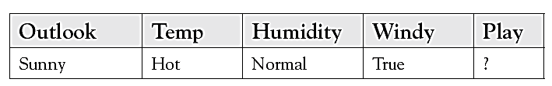
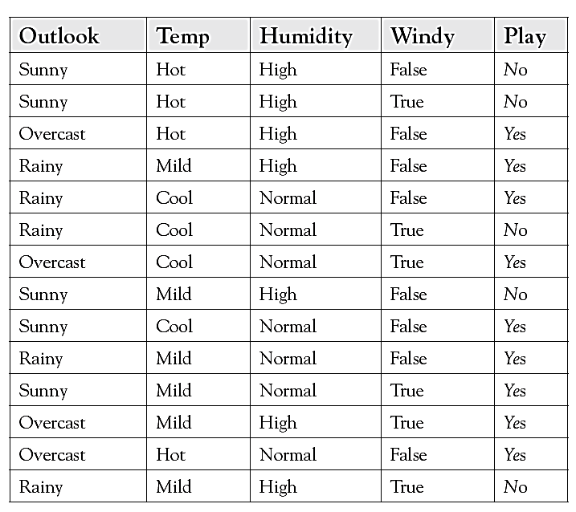
Example

Slide 25
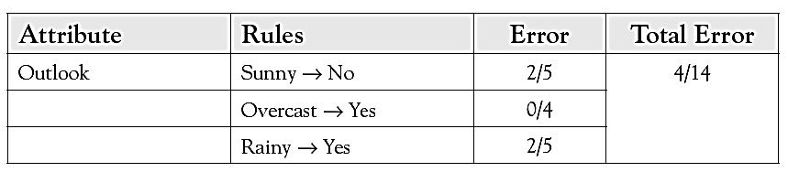
Decision Tree Construction
How should the root node of the tree be determined?
A criterion should be used by which one of these questions gives the most insight about the situation
Start with “Outlook”

Slide 26
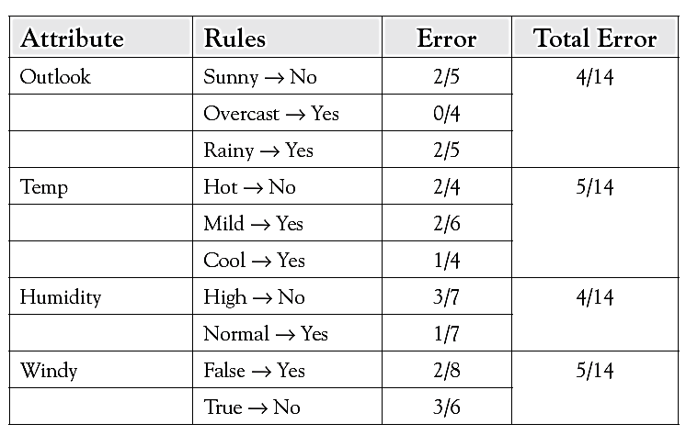
Other Variables

Slide 27
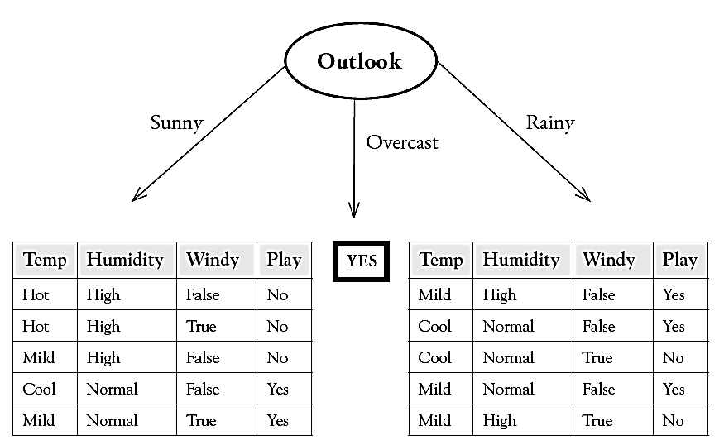
Tree

Slide 28
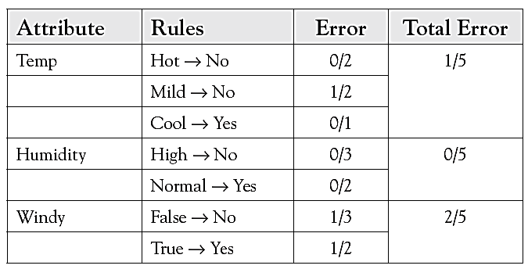
Determining the next nodes of the tree
For the sunny branch on the left, error values will be calculated for the three other variables: temp, humidity, and windy.

Slide 29
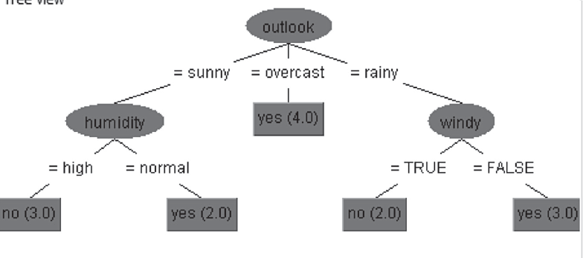
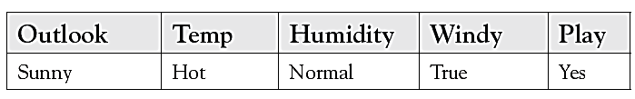
Final DT
Result

Slide 30
Example-2 (hair Length)
Sl. No. | Hair Length | Weight | Age | Class
1 | short | over | middle | M
2 | long | correct | middle | F
3 | short | low | child | M
4 | medium | low | child | F
5 | medium | low | child | F
6 | short | correct | old | M
7 | long | correct | old | F
8 | long | over | middle | M
9 | medium | over | old | M

Slide 31
Example-2 (Weight)
Sl. No. | Hair Length | Weight | Age | Class
1 | short | over | middle | M
2 | long | correct | middle | F
3 | short | low | child | M
4 | medium | low | child | F
5 | medium | low | child | F
6 | short | correct | old | M
7 | long | correct | old | F
8 | long | over | middle | M
9 | medium | over | old | M

Slide 32
Example-2 (Age)
Sl. No. | Hair Length | Weight | Age | Gender
1 | short | over | middle | M
2 | long | correct | middle | F
3 | short | low | child | M
4 | medium | low | child | F
5 | medium | low | child | F
6 | short | correct | old | M
7 | long | correct | old | F
8 | long | over | middle | M
9 | medium | over | old | M

Slide 33
DT
X = <long, over, middle>
Hair Length
short
medium
long
Weight
Age
M
low
middle
old
over
Weight
F
M
F
correct
over
F
M

Slide 34
Inferences
Accuracy = 100%
The decision tree algorithm selected the minimum number of variables that are needed to solve the problem
This tree is symmetric
It is possible to increase predictive accuracy by making more subtrees and making the tree longer
A perfectly fitting tree has the danger of overfitting the data, thus capturing all the random variations in the data
Decision trees are based strictly on observing patterns within the data, and do not rely on any underlying theory of the problem domain

Slide 35
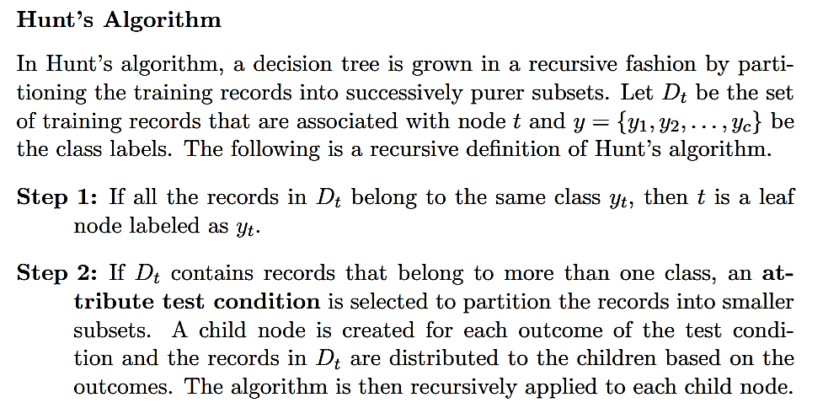
Decision Tree Algorithms

Slide 36
Decision Tree Algorithms…
Create a root node and assign all of the training data to it.
Select the best splitting attribute according to certain criteria.
Add a branch to the root node for each value of the split.
Split the data into mutually exclusive subsets along the lines of the specific split.
Repeat Steps 2 and 3 for each and every leaf node until the stopping criteria is reached.

Slide 37
Algorithms
C5, CART, and CHAID
1. Splitting criteria
a. Which variable to use for the first split? How should one determine the most important variable for the first branch, and subsequently, for each subtree? There are many measures like least errors, information gain, and Gini coefficient.
b. What values to use for the split? If the variables have continuous values, such as for age or BP, what value-ranges should be used to make bins?
c. How many branches should be allowed for each node? There could be binary trees, with just two branches at each node. Or there could be more branches allowed.

Slide 38
Stopping criteria
When to stop building the tree?
There are two major ways to make that determination.
depth of the branches has been reached to some value and the tree becomes unreadable after that.
when the error level at any node is within predefined tolerable levels.

Slide 39
Pruning
The tree could be trimmed to make it more balanced and more easily usable.
The pruning is often done after the tree is constructed, to balance out the tree and improve usability.

Slide 40
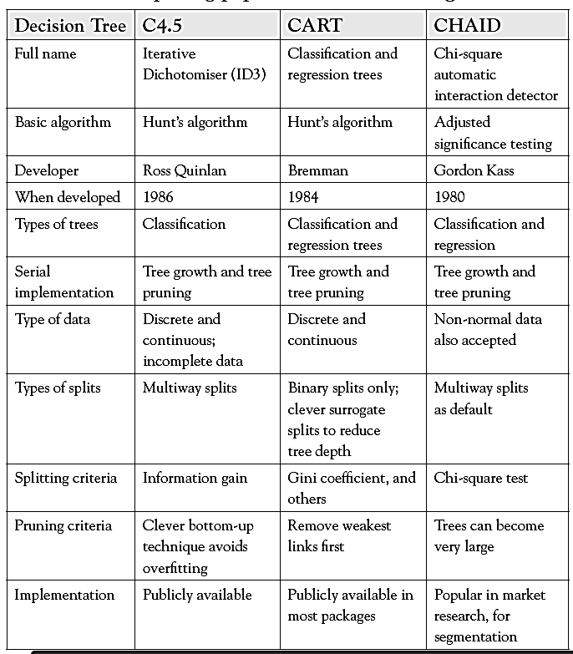
Comparison

Slide 41
Entropy
A formula to calculate the homogeneity of a sample
A completely homogeneous sample has entropy of 0
An equally divided sample has entropy of 1
Entropy(s) = - p+log₂ (p+) -p-log₂ (p-) for a sample of negative and positive elements
The formula for entropy is:
Entropy(S) = - (9/14) Log₂ (9/14) - (5/14) Log₂ (5/14)
= 0.940

Slide 42
Information Gain (IG)
The information gain is based on the decrease in entropy after a dataset is split on an attribute.
Which attribute creates the most homogeneous branches?
First the entropy of the total dataset is calculated.
The dataset is then split on the different attributes.
The entropy for each branch is calculated. Then it is added proportionally, to get total entropy for the split.
The resulting entropy is subtracted from the entropy before the split.
The result is the Information Gain, or decrease in entropy.
The attribute that yields the largest IG is chosen for the decision node.
A branch set with entropy of 0 is a leaf node.
Otherwise, the branch needs further splitting to classify its dataset.
The ID3 algorithm is run recursively on the non-leaf branches, until all data is classified.

Slide 43
Attribute Selection Measure: Information Gain (ID3/C4.5)
Select the attribute with the highest information gain
Let p_{i} be the probability that an arbitrary tuple in D belongs to class C_{i}, estimated by |C_{i, D}|/|D|
Expected information (entropy) needed to classify a tuple in D:
Information needed (after using A to split D into v partitions) to classify D:
Information gained by branching on attribute A
Notes:
I : the expected information needed to classify a given sample
E (entropy) : expected information based on the partitioning into subsets by A

Slide 44
What is ID3?
A mathematical algorithm for building the decision tree
Invented by J. Ross Quinlan in 1979
Uses Information Theory invented by Shannon in 1948
Builds the tree from the top down, with no backtracking
An attribute selection measure is a heuristic for selecting the splitting criteria that best separates a given data set into individual classes
Information Gain (IG) is used to select the most useful attribute for classification

Slide 45










Example
Person | Hair Length | Weight | Age | Class
ShivKumar | 0” | 250 | 36 | M
Pallavi | 10” | 150 | 34 | F
Chavan | 2” | 90 | 10 | M
Vasudha | 6” | 78 | 8 | F
Yamini | 4” | 20 | 1 | F
Murali | 1” | 170 | 70 | M
Pooja | 8” | 160 | 41 | F
Deepak | 10” | 180 | 38 | M
Ameer | 6” | 200 | 45 | M
X | 8” | 290 | 38 | ?

Slide 46
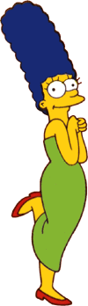

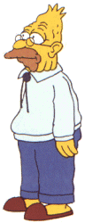
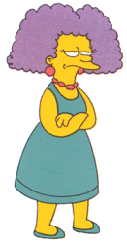
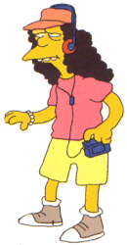
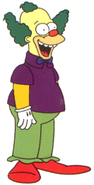
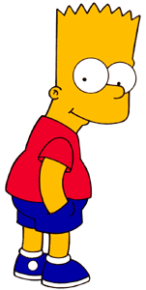

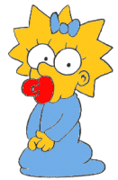
Entropy(4F,5M) = -(4/9)log₂(4/9) - (5/9)log₂(5/9)
= 0.9911
yes
no
Hair Length <= 5?
Let us try splitting on Hair length
Entropy(1F,3M) = -(1/4)log₂(1/4) - (3/4)log₂(3/4)
= 0.8113
Entropy(3F,2M) = -(3/5)log₂(3/5) - (2/5)log₂(2/5)
= 0.9710
Gain(Hair Length <= 5) = 0.9911 – (4/9 * 0.8113 + 5/9 * 0.9710 ) = 0.0911

Slide 47
Entropy(4F,5M) = -(4/9)log₂(4/9) - (5/9)log₂(5/9)
= 0.9911
yes
no
Weight <= 160?
Let us try splitting on Weight
Entropy(4F,1M) = -(4/5)log₂(4/5) - (1/5)log₂(1/5)
= 0.7219
Entropy(0F,4M) = -(0/4)log₂(0/4) - (4/4)log₂(4/4)
= 0
Gain(Weight <= 160) = 0.9911 – (5/9 * 0.7219 + 4/9 * 0 ) = 0.5900

Slide 48
Entropy(4F,5M) = -(4/9)log₂(4/9) - (5/9)log₂(5/9)
= 0.9911
yes
no
age <= 40?
Let us try splitting on Age
Entropy(3F,3M) = -(3/6)log₂(3/6) - (3/6)log₂(3/6)
= 1
Entropy(1F,2M) = -(1/3)log₂(1/3) - (2/3)log₂(2/3)
= 0.9183
Gain(Age <= 40) = 0.9911 – (6/9 * 1 + 3/9 * 0.9183 ) = 0.0183

Slide 49
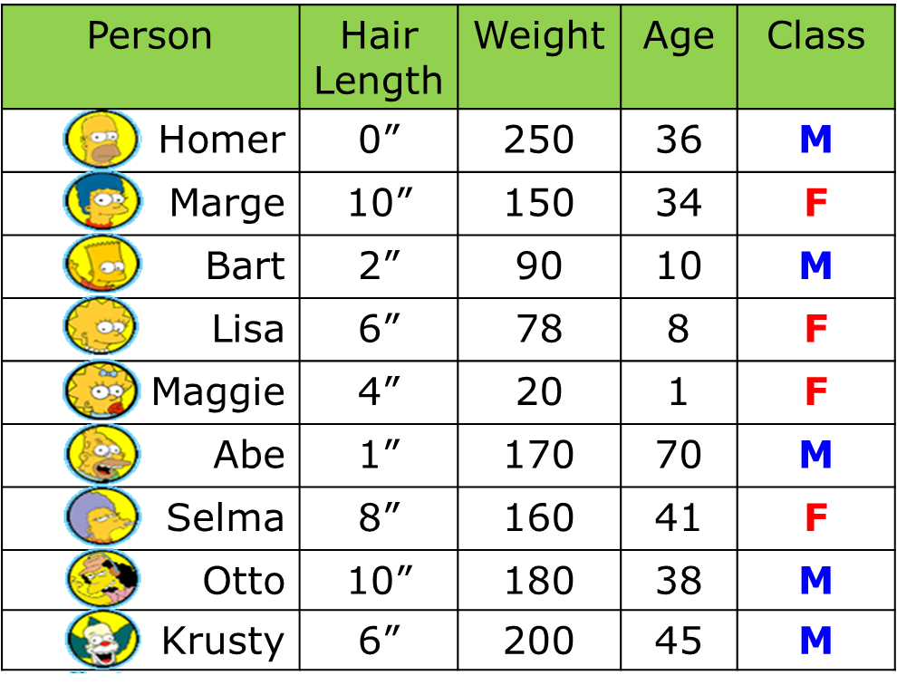
Of the 3 features we had, Weight was best, because of highest IG. But while people who weigh over 160 are perfectly classified (as males), the under 160 people are not perfectly classified… So we simply recurse!
yes
no
Weight <= 160?
This time we find that we can split on Hair length, and we are done!
yes
no
Hair Length <= 2?

Slide 50
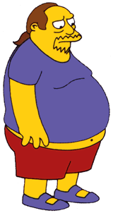
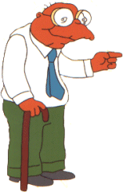
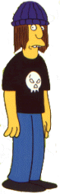
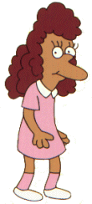
We don’t need to keep the data around, just the test conditions.
Weight <= 160?
yes
no
How would these people be classified?
Hair Length <= 2?
Male
yes
no
Male
Female

Slide 51
Weight <= 160?
It is trivial to convert Decision Trees to rules…
yes
no
Hair Length <= 2?
Male
yes
no
Male
Female
Rules to Classify Males/Females
If Weight greater than 160, classify as Male
Elseif Hair Length less than or equal to 2, classify as Male
Else classify as Female

Slide 52
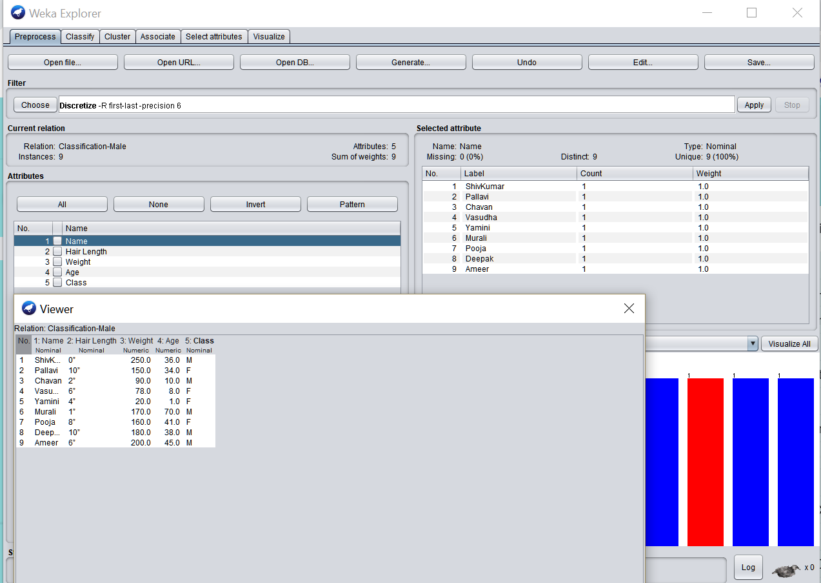
Running in Weka

Slide 53
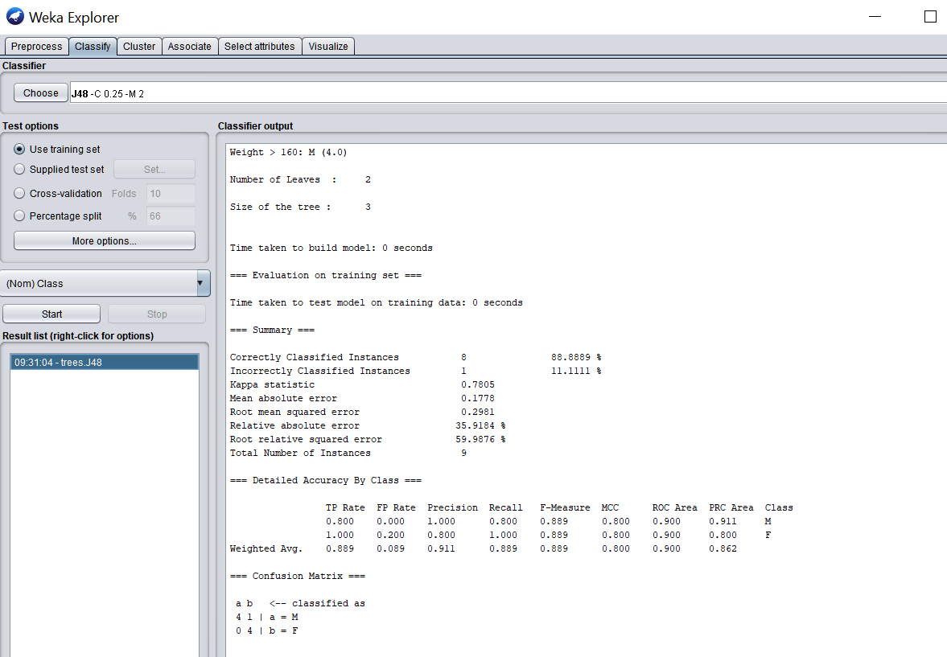
Results – J48

Slide 54
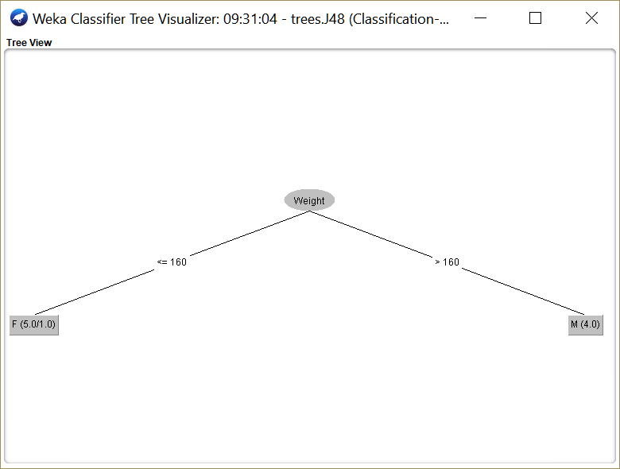
Decision Tree

Slide 55
Regression

Slide 56
Introduction
To model the predictive relationship between several independent variables (DVs) and one dependent variable.
The objective is to find the best-fitting curve for a dependent variable in a multidimensional space, with each independent variable being a dimension.
The curve could be a straight line, or it could be a nonlinear curve.
The quality of fit of the curve to the data can be measured by a coefficient of correlation (r).

Slide 57
Examples
If one wants to estimate the cost of living (dependent variable) of an individual, then the factors such as salary, age, marital status, etc. are independent variables
Exam performance measure: dependent variable – low test score of the student. The independent variables can be the factors like poor attendance, poor memory, low interest level, etc.

Slide 58
Case Study
Nate Silver is a new breed of data-based political forecasters who are seeped in big data and advanced analytics.
In the 2012 elections, he predicted that Obama would win the election with 291 electoral votes, compared to 247 for Mitt Romney, giving the President a 62-percent lead and re-election.
He stunned the political forecasting world by correctly predicting the presidential winner in all 50 states, including all 9 swing states.
He also correctly predicted the winner in 31 of the 33 U.S. Senate races.

Slide 59
Correlations and Relationships
co-relation or correlation: strength of a relationship
It is a quantitative measure. i.e. 0 (zero) and 1.
A correlation of 1 indicates a perfect relationship, where the two variables are in perfect sync.
A correlation of 0 indicates that there is no relationship between the variables.
Measure of correlation = correlation coefficient
= square root of correlation.
This coefficient, called r, can thus range from −1 to +1.
An r value of 0 signifies no relationship.
An r value of +1 shows perfect relationship
An r value of −1 shows a perfect relationship but moving in opposite directions.

Slide 60
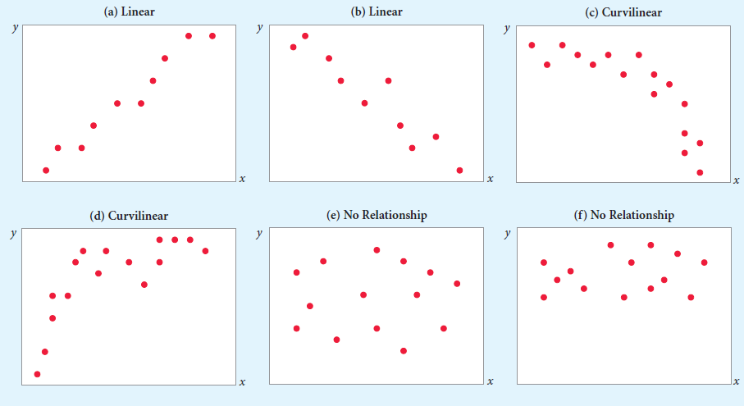
Example

Slide 61
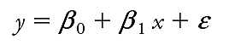
Exercise
House Price | Size (sqft)
$229,500 | 1850
$273,300 | 2190
$247,000 | 2100
$195,100 | 1930
$261,000 | 2300
$179,700 | 1710
$168,500 | 1550
$234,400 | 1920
$168,800 | 1840
$180,400 | 1720
$156,200 | 1660
$288,350 | 2405
$186,750 | 1525
$202,100 | 2030
$256,800 | 2240
T﻿he regression model is described as a linear equation that follows.
y - dependent variable/predicted variable.
x - independent variable/predictor variable.
parameters: β₀ is the intercept of the regression line; that is the predicted value when x = 0 . β₁ is the slope of the regression line.
There could be many predictor variables (such as x1, x2, . . .) in a regression equation. However, there can be only one dependent variable (y)

Slide 62
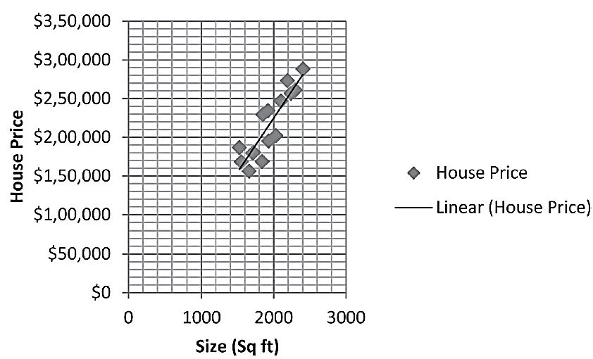
Example
House Price | Size (sqft)
$229,500 | 1850
$273,300 | 2190
$247,000 | 2100
$195,100 | 1930
$261,000 | 2300
$179,700 | 1710
$168,500 | 1550
$234,400 | 1920
$168,800 | 1840
$180,400 | 1720
$156,200 | 1660
$288,350 | 2405
$186,750 | 1525
$202,100 | 2030
$256,800 | 2240

Slide 63
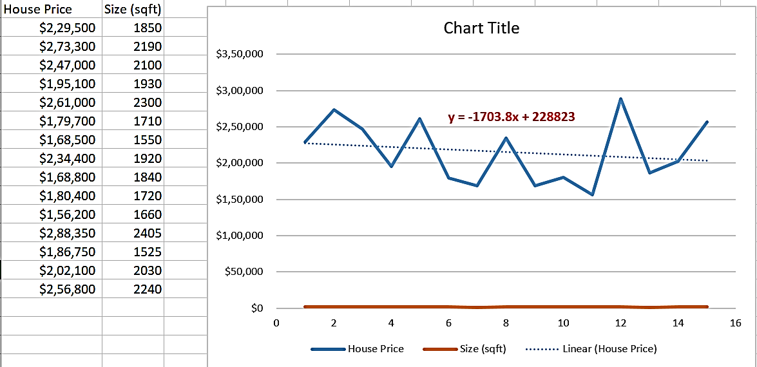
In Excel

Slide 64
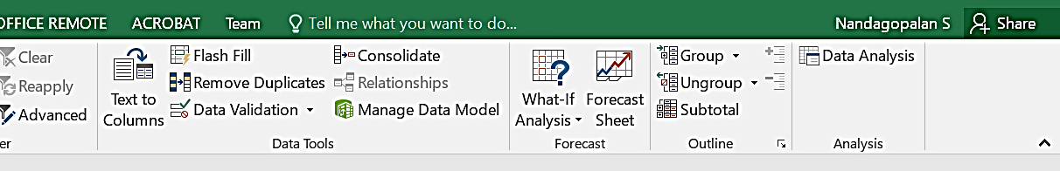
Regression Analysis

Slide 65
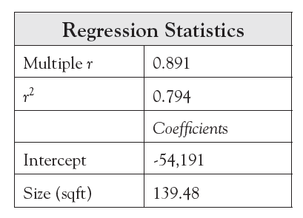
Result
House Price ($) = 139.48 × Size (sqft) − 54,191
This equation explains only 79% of the variance in house prices.

Slide 66
Another Scenario
House Price | Size (sqft) | #Rooms
$229,500 | 1850 | 4
$273,300 | 2190 | 5
$247,000 | 2100 | 4
$195,100 | 1930 | 3
$261,000 | 2300 | 4
$179,700 | 1710 | 2
$168,500 | 1550 | 2
$234,400 | 1920 | 4
$168,800 | 1840 | 2
$180,400 | 1720 | 2
$156,200 | 1660 | 2
$288,350 | 2405 | 5
$186,750 | 1525 | 3
$202,100 | 2030 | 2
$256,800 | 2240 | 4

Slide 67
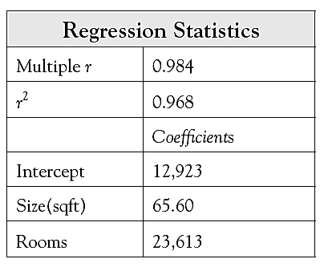
Result
House Price ($) =
65.6 × Size (sqft) + 23,613 × Rooms + 12,924
This equation shows a 97% goodness-of-fit with the data

Slide 68
Hands-on
https://www.youtube.com/watch?v=GhrxgbQnEEU
https://www.youtube.com/watch?v=JvS2triCgOY&feature=emb_rel_pause

Slide 69
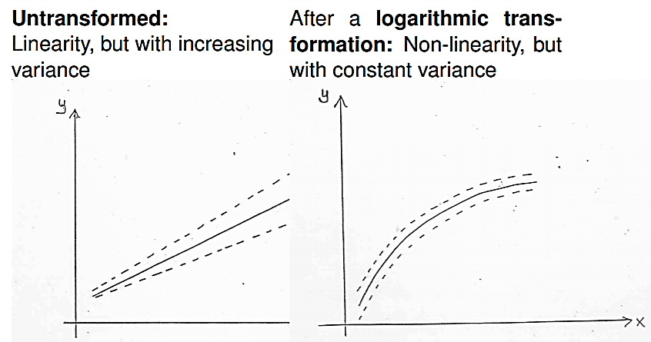
Nonlinear Regression Exercise
The relationship between the variables may also be curvilinear.

Slide 70
Example
Given past data from electricity consumption (kWh) and temperature (temp), the objective is to predict the electrical consumption from the temperature value.
Temp | Kwatts
59.2 | 9,730
61.9 | 9,750
55.1 | 10,180
66.2 | 10,230
52.1 | 10,800
69.9 | 11,160
46.8 | 12,530
76.8 | 13,910
79.7 | 15,110
79.3 | 15,690
80.2 | 17,020
83.3 | 17,880

Slide 71
Plot

Slide 72
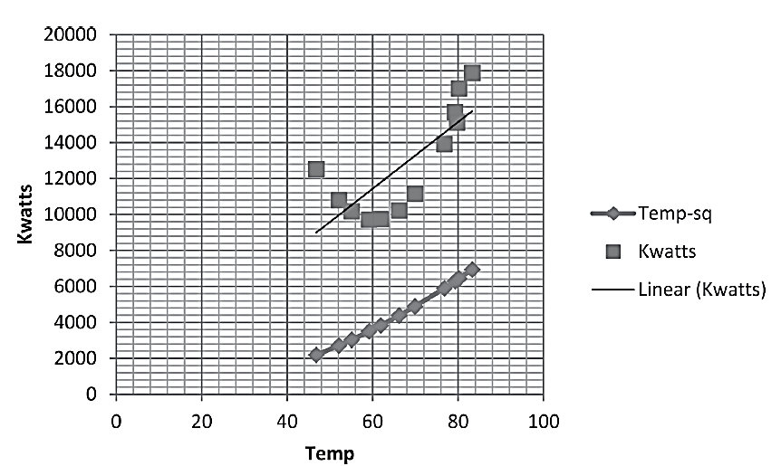
Comparison
The relationship between temperature and Kwatts follows a curvilinear model
Energy consumption with shows temp-sq a strong linear relationship

Slide 73
Advantages
Regression models are easy to understand as they are built upon basic statistical principles, such as correlation and least square error.
Regression models provide simple algebraic equations that are easy to understand and use.
The strength (or the goodness of fit) of the regression model is measured in terms of the correlation coefficients, and other related statistical parameters that are well understood.
Regression models can match and beat the predictive power of other modeling techniques.
Regression models can include all the variables that one wants to include in the model.
Regression modeling tools are pervasive. They are found in statistical packages as well as data mining packages. MS Excel spreadsheets can also provide simple regression modeling capabilities.

Slide 74
Disadvantages
Regression models cannot cover for poor data quality issues
Regression models suffer from collinear problems (meaning strong linear correlations among some independent variables).
Regression models will not automatically choose between highly collinear variables, although some packages attempt to do that.
Regression models do not automatically take care of nonlinearity
Regression models work only with numeric data and not with categorical variables.

Slide 75
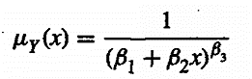
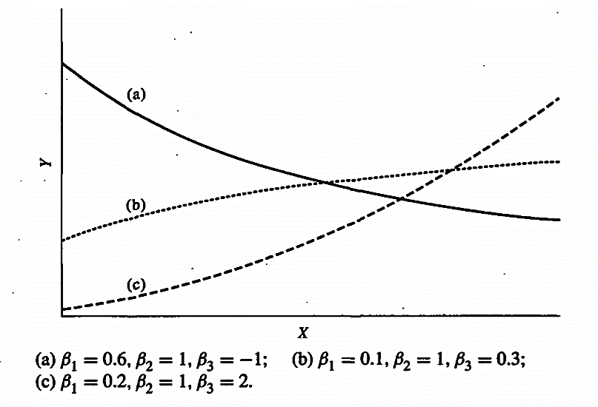
Examples

Slide 76
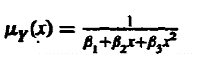
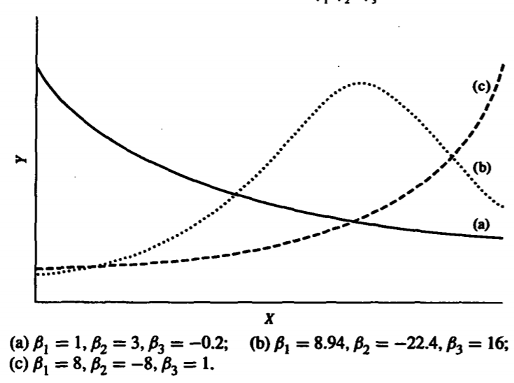
Example…

Slide 77
A N N

Slide 78
Introduction
Artificial neural networks (ANNs) are inspired by the information processing model of the mind/brain.
The human brain consists of billions of neurons that link with one another in an intricate pattern.
Every neuron receives information from many other neurons, processes it, gets excited or not, and passes its state information to other neurons.

Slide 79
What is ANN?
ANNs are composed of a large number of highly interconnected processing elements (neurons) working in a multilayered structures that receive inputs, process the inputs, and produce an output.
An ANN is designed for a specific application, such as pattern recognition or data classification, and trained through a learning process.
Just like in biological systems, ANNs make adjustments to the synaptic connections with each learning instance.

Slide 80
Artificial Neural Networks (ANN)
Output Y is 1 if at least two of the three inputs are equal to 1.

Slide 81
Artificial Neural Networks (ANN)

Slide 82
Artificial Neural Networks (ANN)
Model is an assembly of inter-connected nodes and weighted links
Output node sums up each of its input value according to the weights of its links
Compare output node against some threshold t
Perceptron Model

Slide 83
General Structure of ANN
Training ANN means learning the weights of the neurons

Slide 84
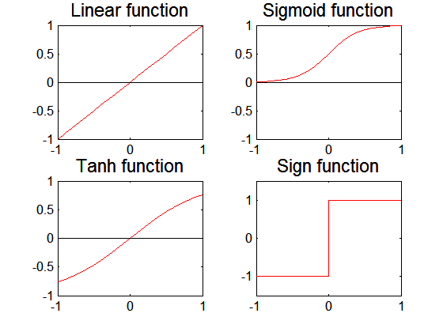
Artificial Neural Networks (ANN)
Various types of neural network topology
single-layered network (perceptron) versus multi-layered network
Feed-forward versus recurrent network
Various types of activation functions (f)

Slide 85
Perceptron
Single layer network
Contains only input and output nodes
Activation function: f = sign(w•x)
Applying model is straightforward
X₁ = 1, X₂ = 0, X₃ =1 => y = sign(0.2) = 1

Slide 86
Perceptron Learning Rule
Initialize the weights (w₀, w₁, …, w_{d})
Repeat
For each training example (x_{i}, y_{i})
Compute f(w, x_{i})
Update the weights:
Until stopping condition is met

Slide 87
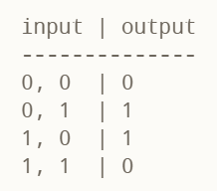
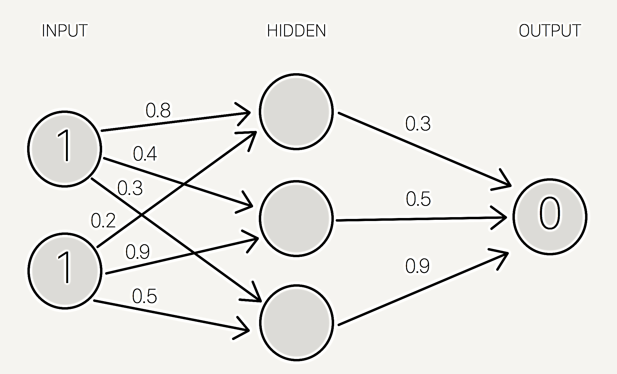
Exercise - Forward Propagation
XOR function
weights are selected randomly (based on Gaussian distribution) since it is the first time we’re forward propagating. The initial weights will be between 0 and 1, but note that the final weights don’t need to be.

Slide 88
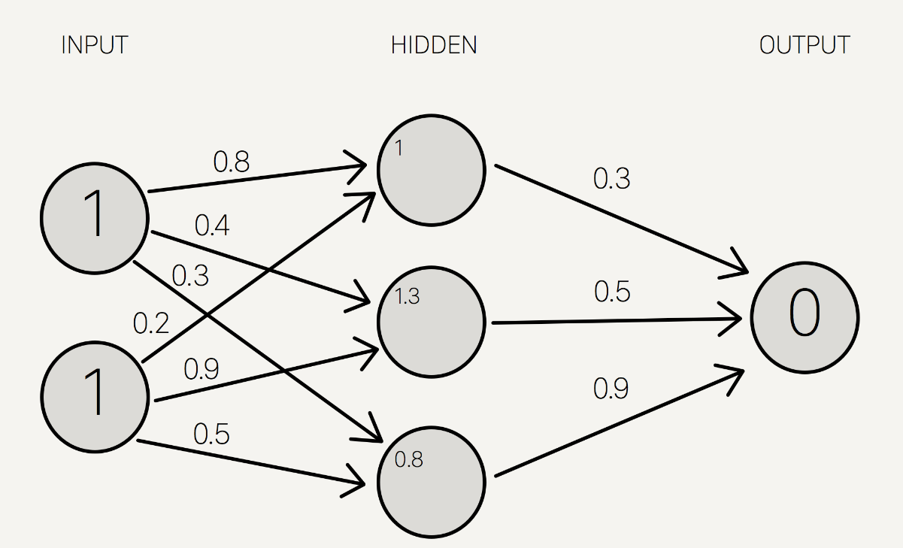
Weight Calculation
1 * 0.8 + 1 * 0.2 = 1
1 * 0.4 + 1 * 0.9 = 1.3
1 * 0.3 + 1 * 0.5 = 0.8

Slide 89
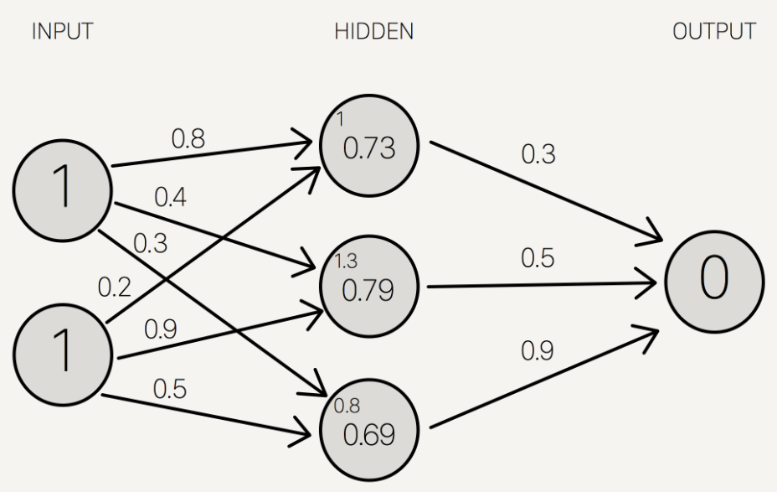
Apply Activation Function
To get the final value, we apply the activation function to the hidden layer sums.
The purpose of the activation function is to transform the input signal into an output signal and are necessary for neural networks to model complex non-linear patterns that simpler models might miss.
S(1.0) = 0.73105857863
S(1.3) = 0.78583498304
S(0.8) = 0.68997448112
Sigmoid function is used

Slide 90
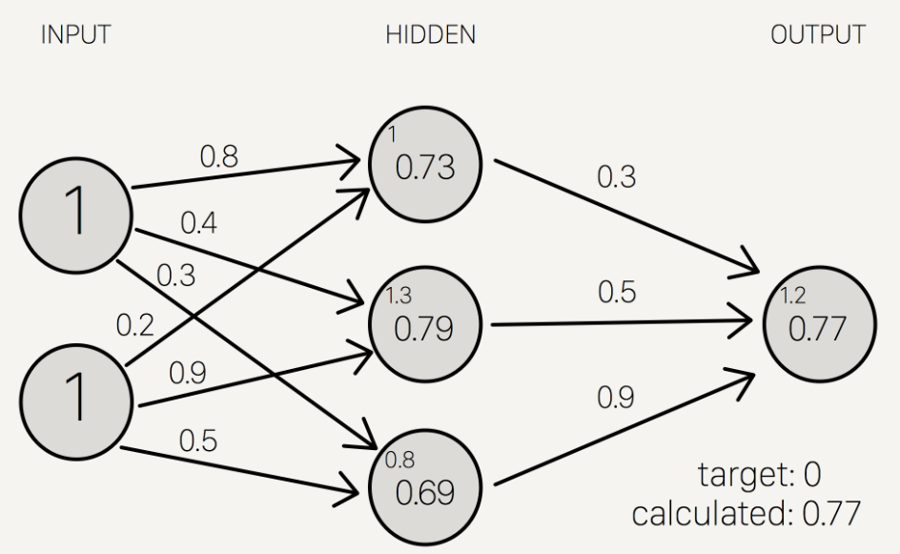
Output
0.73 * 0.3 + 0.79 * 0.5 + 0.69 * 0.9 = 1.235
S(1.235) = 0.7746924929149283

Slide 91
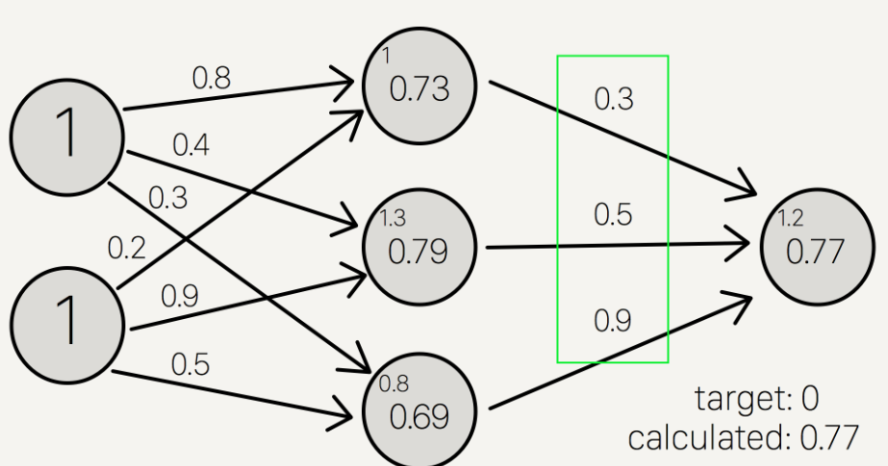
Back propagation
To improve our model, we first have to quantify just how wrong our predictions are.
Then, we adjust the weights accordingly so that the margin of errors are decreased.
Similar to forward propagation, back propagation calculations occur at each “layer”.
We begin by changing the weights between the hidden layer and the output layer.

Slide 92
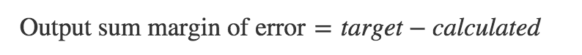
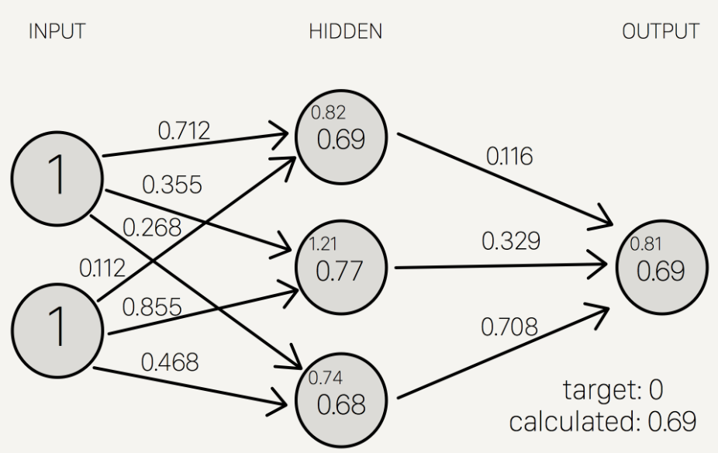
Adjusting the Weights
Target = 0
Calculated = 0.77
Target - calculated = -0.77
Still not Good!

Slide 93
Perceptron Learning Rule
Weight update formula:
Intuition:
Update weight based on error:
If y=f(x,w), e=0: no update needed
If y>f(x,w), e=2: weight must be increased so that f(x,w) will increase
If y<f(x,w), e=-2: weight must be decreased so that f(x,w) will decrease

Slide 94
Example of Perceptron Learning

Slide 95
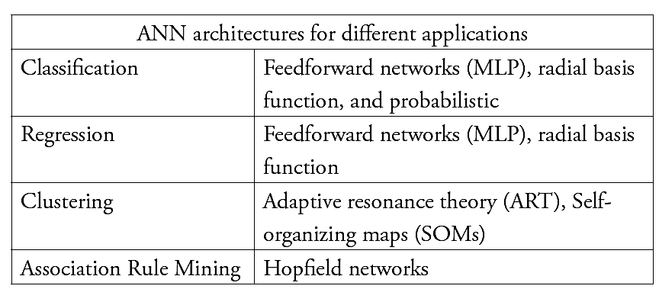
Architecting an ANN
The most popular architecture is a feed forward, multilayered perceptron (MLP) with back-propagation learning algorithm

Slide 96
Developing an ANN
Gather data: Divide into training data and test data. The training data needs to be further divided into training data and validation data.
Select the network architecture, such as feedforward network.
Select the algorithm, such as Multilayer Perception.
Set network parameters.
Train the ANN with training data.
Validate the model with validation data.
Freeze the weights and other parameters.
Test the trained network with test data.
Deploy the ANN when it achieves good predictive accuracy.

Slide 97

Training

Slide 98
SOM – Self Organizing Map
Initialize each node’s weights.
Present a randomly selected input vector to the lattice.
Determine most resembling (winning) node.
Determine the neighboring nodes.
Adjust the winning and neighboring nodes (make them more like the input vector)
Repeat steps 2-5 for until a stopping criteria is reached

Slide 99
Advantages of ANN
ANN can deal with (identify/model) highly nonlinear relationships on their own, without much work from the user or analyst.
There is no need to program ANN neural networks, as they learn from examples.
ANN can handle a variety of problem types, including classification, clustering, associations, and so on.
ANNs are tolerant of data quality issues, and they do not restrict the data to follow strict normality.
ANN can handle both numerical and categorical variables.
ANNs can be much faster than other techniques.
Most importantly, ANN usually provide better results (prediction and/or clustering) compared to statistical counterparts.

Slide 100
Disadvantages
They are deemed to be black-box solutions, lacking explainability.
Optimal design of ANN is still an art: It requires expertise and extensive experimentation.
It can be difficult to handle a large number of variables (especially the rich nominal attributes) with an ANN.
It takes large data sets to train an ANN.

Slide 101
Cluster Analysis

Slide 102
Introduction
Automatic identification of natural groupings of things
Data instances that are similar to (or near) each other are categorized into one cluster.
Similarly, data instances that are very different (or far away) from each other are moved into different clusters.
Clustering is an unsupervised learning technique - why? no output or dependent variable for which a right or wrong answer can be computed.

Slide 103





Example – Image Segmentation
Original k = 2
k = 2 k = 3

Slide 104
Applications
Pattern Recognition
Spatial Data Analysis
Create thematic maps in GIS by clustering feature spaces
Detect spatial clusters or for other spatial mining tasks
Digital Image Processing
Economic Science (especially market research)
Web
Document classification
Cluster Weblog data to discover groups of similar access patterns

Slide 105
Applications…
Marketing
Help marketers discover distinct groups in their customer bases, and then use this knowledge to develop targeted marketing programs
Land use
Identification of areas of similar land use in an earth observation database
Insurance
Identifying groups of motor insurance policy holders with a high average claim cost
City-planning
Identifying groups of houses according to their house type, value, and geographical location
Earth-quake studies
Observed earth quake epicenters should be clustered along continent faults

Slide 106
Quality of Clustering
A good clustering method will produce high quality clusters with
high intra-class similarity
low inter-class similarity
The quality of a clustering result depends on both the similarity measure used by the method and its implementation
The quality of a clustering method is also measured by its ability to discover some or all of the hidden patterns

Slide 107
Case Study
A national insurance company distributes its personal and small commercial insurance products through independent agents.
They wanted to increase their sales by better understanding their customers
They were also interested in examining different customer segments based on their needs, and the profitability of each of those segments
They gathered attitudinal, behavioral, and demographic data using a mail survey of 2000 U.S. households that own auto insurance

Slide 108
Outcome
Non-Traditionals: interested in using the Internet and/or buying insurance at work.
Direct Buyers: interested in buying via direct mail or telephone.
Budget Conscious: interested in minimal coverage and finding the best deal.
Agent Loyals: expressed strong loyalty to their agents and high levels of personal service.
Hassle-Free: similar to Agent Loyals but less interested in faceto-face service.

Slide 109

Cluster Problem
Given a representation of n objects, find K groups based on a measure of similarity, such that objects within the same group are “similar” but the objects in different groups are “not similar”.
What is “similarity”?
This data set has three natural groups of data points, i.e., 3 natural clusters.

Slide 110
Representing Clusters
The clusters can be represented by a central or modal value.
A cluster can be defined as the “centroid” of the collection of points belonging to it.
A centroid is a measure of central tendency. It is the point from where the sum total of squared distance from all the points is the minimum.
A real life equivalent would be the city center as the point that is considered the most easy to use by all constituents of the city. Thus, all cities are defined by their centers or downtown areas.

Slide 111
Clustering Methods
Partitioning approach
Construct various partitions and then evaluate them by some criterion, e.g., minimizing the sum of square errors
Typical methods: k-means, k-medoids, CLARANS
Hierarchical approach
Create a hierarchical decomposition of the set of data (or objects) using some criterion. Uses bottom-up approach. i.e. each object is a group and merge similar groups.
Typical methods: Diana, Agnes, BIRCH, ROCK, CAMELEON
Density-based approach
Based on connectivity and density functions
Cluster based on distance between objects
Typical methods: DBSACN, OPTICS, DenClue

Slide 112
The K-Means Clustering Method
10
10
9
9
8
8
7
7
6
6
5
5
4
Assign each objects to most similar center
Update the cluster means
4
3
3
2
2
1
1
0
0
0
1
2
3
4
5
6
7
8
9
10
0
1
2
3
4
5
6
7
8
9
10
reassign
reassign
k=2
Arbitrarily choose k object as initial cluster center
Update the cluster means

Slide 113
k-Means Algorithm
Given k, the k-means algorithm is implemented in the following way:
Algorithm k-means
// k - no. of clusters
// D – data set containing n objects
Arbitrarily choose k objects from D as the initial clusters
Repeat
(re)assign each object to the cluster to which the object is the most similar, based on the mean value of the objects in the cluster
Update the cluster means. i.e. calculate the mean value of the objects for each cluster
Until no change

Slide 114
Exercise
Problem: Cluster the following eight points (with (x, y) representing locations) into three clusters:
A1(2, 10), A2(2, 5), A3(8, 4), A4(5, 8)
A5(7, 5), A6(6, 4), A7(1, 2), A8(4, 9).
Initial cluster centers are: A1(2, 10), A4(5, 8), and A7(1, 2)
The distance function between two points a = (x1, y1) and b = (x2, y2) is defined as:
ρ(a, b) = |x2 – x1| + |y2 – y1|
Use k-means algorithm to find the three cluster centers after the second iteration.

Slide 115
A1(2, 10), A2(2, 5), A3(8, 4), A4(5, 8), A5(7, 5), A6(6, 4) A7(1, 2), A8(4, 9).
k = 3
Initial cluster centers are: A1(2, 10), A4(5, 8) and A7(1, 2)
Iteration – 1
K₁ = {A1}, K₂ = {A3, A4, A5, A6, A8},
K₃ = {A2, A7}
m₁ = (2, 10), m₂ = (6, 6), m₃ = (1.5, 3.5)
 | Point | (2, 10) | (5, 8) | (1, 2) | Cluster
A1 | (2, 10) | 0 | 5 | 9 | 1
A2 | (2, 5) | 5 | 6 | 4 | 3
A3 | (8, 4) | 12 | 7 | 9 | 2
A4 | (5, 8) | 5 | 0 | 10 | 2
A5 | (7, 5) | 10 | 5 | 9 | 2
A6 | (6, 4) | 10 | 5 | 7 | 2
A7 | (1, 2) | 9 | 10 | 0 | 3
A8 | (4, 9) | 3 | 2 | 10 | 2

Slide 116
Example-2 (Contd…)
Iteration – 2
K₁ = {A1, A8}, K₂ = {A3, A4, A5, A6}, K₃ = {A2,A7}
m₁ = (3, 9.5), m₂ = (6.5, 5.25), m₃ = (1.5, 3.5)
 | Point | (2, 10) | (6, 6) | (1.5, 3.5) | Cluster
A1 | (2, 10) | 0 | 8 | 7 | 1
A2 | (2, 5) | 5 | 5 | 2 | 3
A3 | (8, 4) | 12 | 4 | 8 | 2
A4 | (5, 8) | 5 | 3 | 8 | 2
A5 | (7, 5) | 10 | 2 | 7 | 2
A6 | (6, 4) | 10 | 2 | 5 | 2
A7 | (1, 2) | 9 | 9 | 2 | 3
A8 | (4, 9) | 3 | 5 | 8 | 1

Slide 117
Example -2 (Contd…)
Iteration – 3
K₁ = {A1, A4, A8}, K₂ = {A3,A5,A6}, K₃ = {A2,A7}
m₁ = (3.66, 9.0), m₂ = (7.0, 4.33), m₃ = (1.5, 3.5)
 | Point | (3, 9.5) | (6.5, 5.25) | (1.5, 3.5) | Cluster
A1 | (2, 10) | 1.5 | 9.25 | 7.0 | 1
A2 | (2, 5) | 5.5 | 4.75 | 3.0 | 3
A3 | (8, 4) | 10.5 | 3.75 | 8.0 | 2
A4 | (5, 8) | 3.5 | 4.75 | 10.0 | 1
A5 | (7, 5) | 8.5 | 1.75 | 9.0 | 2
A6 | (6, 4) | 8.5 | 1.75 | 6.0 | 2
A7 | (1, 2) | 9.5 | 8.75 | 2.0 | 3
A8 | (4, 9) | 1.5 | 7.75 | 10.0 | 1

Slide 118

Results
K₁ = {A1, A4, A8}, K₂ = {A3,A5,A6}, K₃ = {A2,A7}

Slide 119
Exercise 2
X Y
2 4
2 6
5 6
4 7
8 3
6 6
5 2
5 7
6 3
4 4
Seed points
(2,6) and (8,3).

Slide 120
Exercise 2
Seed points
(4,7) and (5,2).
X Y
2 4
2 6
5 6
4 7
8 3
6 6
5 2
5 7
6 3
4 4
 | Point | (4, 7) | (5, 2) | Cluster
A1 | 2,4 | 5 | 5 | C2
A2 | 2,6 | 3 | 7 | C1
A3 | 5,6 | 2 | 4 | C1
A4 | 4,7 | 0 | 6 | C1
A5 | 8,3 | 8 | 4 | C2
A6 | 6,6 | 3 | 5 | C1
A7 | 5,2 | 6 | 0 | C2
A8 | 5,7 | 1 | 5 | C1
A9 | 6,3 | 6 | 2 | C2
A10 | 4,4 | 3 | 3 | C2

Slide 121
Selecting the Number of Clusters
The correct choice of the value of K is often ambiguous.
It depends on the shape and scale of the distribution points in a data set and the desired clustering resolution of the user.
Heuristics are needed to pick the right number.
One can graph the percentage of variance explained by the clusters against the number of clusters.

Slide 122


Elbow method
At that elbow point, adding more clusters will not add much incremental value. That would be the desired value of K

Slide 123
Advantages
K-means algorithm is simple, easy to understand, and easy to implement.
It is also efficient, in which the time taken to cluster K-means rises linearly with the number of data points.
No other clustering algorithm performs better than K-means, in general.

Slide 124
Disadvantages
The user needs to specify an initial value of K.
T﻿he process of finding the clusters may not converge.
It is not suitable for discovering clusters that are not hyperellipsoids (or hyperspheres).

Slide 125
Association Rule Mining

Slide 126
Introduction
Unsupervised learning technique, used in business.
Helps to identify shopping patterns - market basket analysis.
Finds interesting relationships (affinities) between variables (items or events).
Used in cross-sell related items and increase the size of a sale.
Eg. “a Customer who bought a laptop computer and virus protection software also bought an extended service plan 70 percent of the time.”

Slide 127

Market-Basket Problem

Slide 128
Case Study - NetFlix
Searches the CineMatch database for people who have rated the same movie—for example, “The Return of the Jedi.”
Determines which of those people have also rated a second movie, such as “The Matrix.”
Calculates the statistical likelihood that people who liked “Return of the Jedi” will also like “The Matrix.”
Continues this process to establish a pattern of correlations between subscribers’ ratings of many different films.

Slide 129
Market - Basket Analysis
To learn more about the buying patterns of the customers
Helps: plan marketing, advertising strategies, design of new catalogs, etc.
Universe as the set of items available at the store. Each item has a Boolean variable (present/absence)
This boolean vector can be analyzed for buying patterns – association rules
Computer → antivirus_software [support = 1%, confidence = 50%]
min. support threshold & min. confidence threshold – set by domain experts

Slide 130
Frequent Patterns and Association Rules
Transaction-id | Items bought
10 | A, B, D
20 | A, C, D
30 | A, D, E
40 | B, E, F
50 | B, C, D, E, F
Itemset I = {I₁, …, I_{k}}
Find all the rules A→ B with minimum support and confidence
support, s, probability that a transaction contains P(A∪B)
confidence, c, conditional probability that a transaction having A also contains B. Or, P(B|A)
Customer
buys both
Customer
buys jam
Let sup_{min} = 50%, conf_{min} = 50%
Freq. Pat.: {A:3, B:3, D:4, E:3, AD:3}
Association rules:
A → D (60%, 100%),
s = N_{A,D}/N, c = N_{A,D}/N_{A}
D → A (60%, 75%)
Customer
buys bread

Slide 131
Apriori Pseudo Code
The Apriori Algorithm: Finding frequent Itemsets using candidate generation
Uses the prior knowledge of frequent itemset
Apriori property: “All non-empty subsets of a frequent itemset must also be frequent”
k-itemsets are used to explore (k+1) itemset
L₁ – one-itemset, L₂ – 2-itemset, L_{k} – k-itemset , etc
Step-1: Join step: To find L_{k}, a set of candidate k-itemset is generated by joining L_{k-1} with itself, denote as C_{k}.
Step-2: Prune step: C_{k} is superset of L_{k}, i.e. its members may or may not be frequent, but all of the frequent k-itemsets are included in C_{k}. Do subset testing.
Dr. S. Nandagopalan

Slide 132

Exercise 1
TID | Item ids
T100 | I1, I2, I5
T200 | I2, I4
T300 | I2, I3
T400 | I1, I2, I4
T500 | I1, I3
T600 | I2, I3
T700 | I1, I3
T800 | I1, I2, I3, I5
T900 | I1, I2, I3

Slide 133
The Apriori Algorithm
// C_{k}: Candidate itemset of size k
// L_{k} : frequent itemset of size k
L₁ = {frequent items};
for (k = 1; L_{k} !=∅; k++) do
C_{k+1} = candidates generated from L_{k};
for each transaction t in database do
increment the count of all candidates in C_{k+1} that are contained in t
endfor
L_{k+1} = candidates in C_{k+1} with min_support
endfor
return ∪_{k} L_{k};

Slide 134
Generating Association rules from frequent itemsets
For each frequent itemset I, generate all nonempty subsets of I
For every nonempty subset s of I, output the rule:
s → (l - s),
if support_count(l) / support_count(s) >= min_conf_thres
Example:
Consider a frequent itemset: l = {I1, I2, I5}. What are the association rules for l ?
Non-empty subsets of I = {I1, I2}, {I1, I5}, {I2, I5}, {I1}, {I2}, {I5}
I1 I2 I5 confidence = 2/4 = 50%
I1 I5 I2 confidence = 2/2 = 100%
I2 I5 I1 confidence = 2/2 = 100%
I1 I2 I5 confidence = 2/6 = 33%
I2 I1 I5 confidence = 2/7 = 29%
I5 I1 I2 confidence = 2/2 = 100%
c = N_{A,D}/N_{A}

Slide 135


Exercise 2 MSV = 4

Slide 136
Association Rules
{Milk, Bread, Butter} = 6
(Bread, Butter) → Milk {S = 50%, C = 67%}.
(Milk, Bread) → Butter {S = 50%, C = 84%}.
(Milk, Butter) → Bread {S = 50%, C = 84%}.
Association rules help figure affinities between products in transactions.

Slide 137
Summary

